Slide 1



Vendas Final
View in Power BI
Last data refresh:
19/05/2022 23:12:32 UTC
Downloaded at:
20/05/2022 02:31:51 UTC

Slide 2
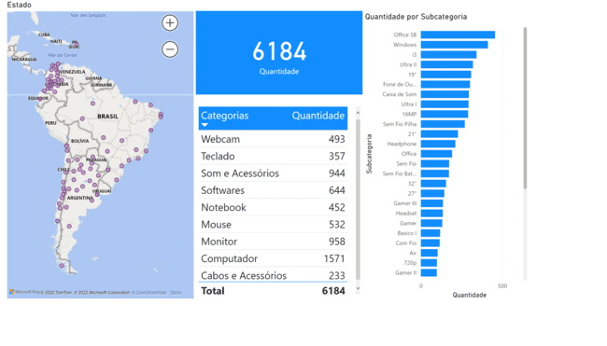
Geral
Notes:
map
No alt text provided
card
No alt text provided
tableEx
No alt text provided
clusteredBarChart
No alt text provided

Slide 3
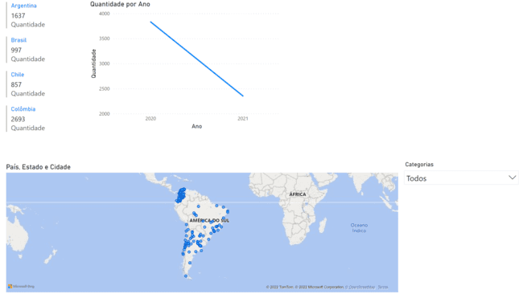
Localização
Notes:
multiRowCard
No alt text provided
lineChart
No alt text provided
map
No alt text provided
slicer
No alt text provided

Slide 4
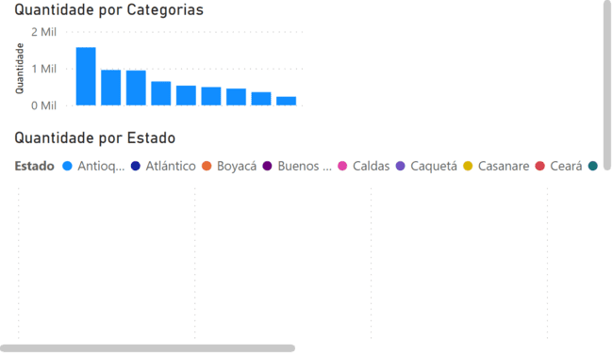
Por Categoria
Notes:
clusteredColumnChart
No alt text provided
clusteredBarChart
No alt text provided

